Slide 1
ORGANIZATION OF PROGRAMMING LANGUAGES

Slide 2
Language Implementation in Programming
Language implementation refers to the process of creating a system that can execute programs written in a specific programming language.
This includes the design and development of compilers, interpreters, and runtime environments that translate high-level code into machine code or directly execute it

Slide 3
COMPONENTS AND CONCEPTS INVOLVED IN LANGUAGE IMPLEMENTATION.
1. Interpreters vs. Compilers
• Interpreters:
An interpreter translates high-level code into machine code line-by-line or statement-by-statement, executing each line as it is translated.
This approach allows for immediate execution and easier debugging but can be slower than compiled code.
Example: Python is primarily an interpreted language.
.

Slide 4
Compilers:
A compiler translates the entire high-level program into machine code before execution. The generated machine code is then executed independently of the source code.
This can lead to faster execution times but requires a separate compilation step before running the program.
Example: C and C++ are typically compiled languages.
programmer.

Slide 5
Syntax and Semantics in Programming Languages
A programming language is defined by two fundamental components:
how it looks (syntax) and
what it means (semantics).
Together, they form the rules that allow humans to write code that computers can execute correctly.

Slide 6
Syntax: The Form of Code
Syntax refers to the structural rules governing the combination of symbols that form a correctly structured program.
It defines the grammar of the language but ignores the actual meaning of the statements.
Components of Syntax
Lexemes: The lowest-level syntactic units (e.g., total, *, 30).
Tokens: Categories of lexemes (e.g., identifier, operator, literal).

Slide 7
1. Lexical Elements
Before a compiler or interpreter can understand the structure of your code, it must break down the raw character stream into the smallest meaningful units called lexemes. These lexemes are then categorized into abstract groups called tokens.
Think of lexemes as the raw "words" and tokens as the "parts of speech" (like nouns, verbs, and punctuation).
Raw Source Code: [ total ] [ = ] [ base ] [ + ] [ 10 ]
│ │ │ │ │
Lexemes: "total" "=" "base" "+" "10"
│ │ │ │ │
Tokens: Identifier Operator Identifier Operator Literal

Slide 8
Keywords (and Reserved Words)
Definition: Fixed words predefined by the language design that have special structural meanings.
Characteristics: You cannot use these words as name variables or functions because doing so would break the language's core syntax rules.
Examples:
if, else, while (Control flow)
class, return, import (Structure and data routing)

Slide 9
Identifiers
Definition: User-defined names given to variables, functions, classes, and objects.
Lexical Rules: Languages use strict lexical patterns to differentiate identifiers from numbers or keywords.
Most languages enforce that an identifier:
Must start with a letter (\(A-Z, a-z\)) or an underscore (_).
Cannot start with a digit (\(0-9\)).
Cannot contain spaces or special punctuation characters (e.g., @, !, -).
Examples: total_score, calculateTax, user01.

Slide 10
Operators
Definition: Special symbols that trigger specific mathematical, logical, or relational actions on data.
Categories:
Arithmetic: +, -, *, /, %
Relational / Comparison: ==, !=, <, >, <=, >=
Logical: &&, ||, ! (or and, or, not in Python)
Assignment: =, +=, -=

Slide 11
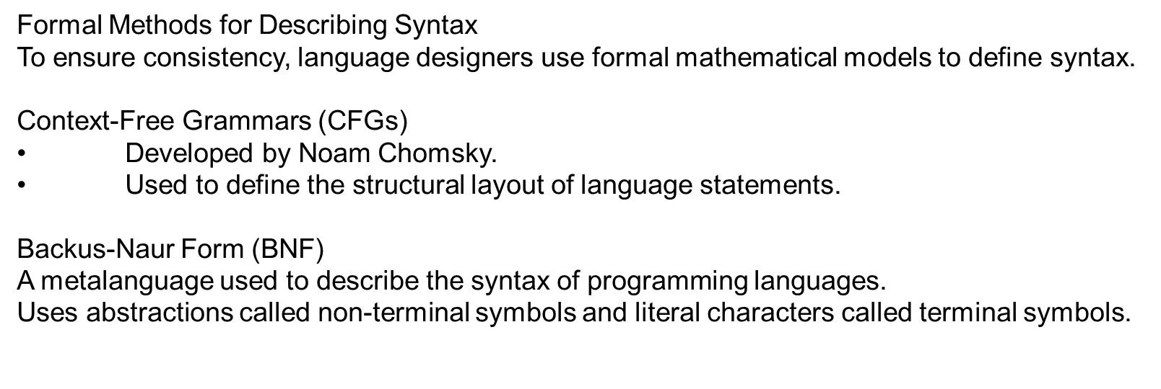

Slide 12
Semantics: The Meaning of Code
While syntax dictates how a program is structured and written, semantics determines what happens when that code actually runs.
Semantics defines the exact behavior, operational effect, and data transformations caused by a programming language construct.
Without semantic rules, a computer program is just an arbitrary collection of text characters.
Semantics bridges the gap between structured source code and actual CPU execution.
The Challenge of Ambiguity
Natural languages (like English) are highly ambiguous. A phrase like "I saw a man with a telescope" can mean multiple things. Computer languages cannot tolerate this ambiguity. Semantics guarantees that a line of code has exactly one predictable meaning on any compliant execution engine.

Slide 13
Semantics: The Meaning of Code
Semantics refers to the meaning of expressions, statements, and program units.
A program can be syntactically flawless but semantically completely invalid.
Example of the Difference
• int x = "apple";
• Syntax: Perfect. It follows the structural rule: type variable = value;.
• Semantics: Broken. You cannot store a text string inside an integer variable type.

Slide 14
How Meaning Changes by Construct
Semantics translates identical syntax structures into entirely different processor actions depending on the data type or context involved:
Declarations: Meaning shifts based on type. int x; tells the system to reserve 4 bytes of memory, while double x; tells it to reserve 8 bytes and format it specifically for floating-point math.
Control Flow: The statement while (condition) { body } carries an operational meaning: evaluate the condition; if true, run the body and jump back to the evaluation step; if false, skip past the loop block entirely.
Expressions and Operators: The plus symbol (+) changes its fundamental behavior based on data types:
Semantics with numbers: 5 + 5 , Arithmetic Addition (Outputs 10).
Semantics with text: "5" + "5" String Concatenation (Outputs "55").

Slide 15
Approaches to Formal Semantics
While syntax is easily defined using BNF, formalizing semantics is much more complex. There are three primary traditional methods used:

Slide 16
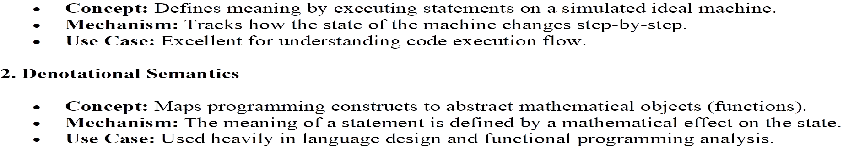

Slide 17
3. Axiomatic Semantics
• Concept: Based on formal mathematical logic.
• Mechanism: Uses assertions called preconditions and postconditions to prove correctness.
•• Use Case: Crucial for formal program verification and safety-critical software.

Slide 18
2. Program errors
When considering types of errors in programming,
it is beneficial if you understand the typical errors programmers run into and how you go about debugging

Slide 19
Programming ERRORS Definition
Syntax Errors. ...
Semantic Errors. ...
Logical Errors. ...
Runtime Errors. ...
Arithmetic Errors. ...
Linker Errors. ...
Resource Errors. ...
Interface Errors.:

Slide 20
Thank you

